Slide 1

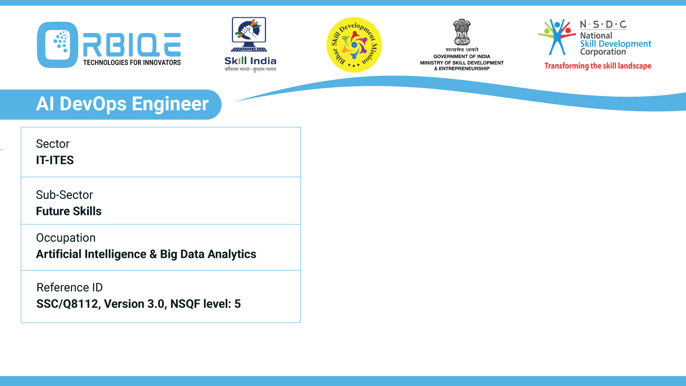
Name- Krishna Kant Dubey

Slide 2

Applying Code Quality Principles

Slide 3
Agenda
Code reviews
Coding standards
Automated testing
Software reliability

Slide 4
Code reviews

Slide 5
Coding standards

Slide 6
Automated testing

Slide 7
Software reliability

Slide 8
Thank You

